Slide 1
Cooking Challenge

Slide 2
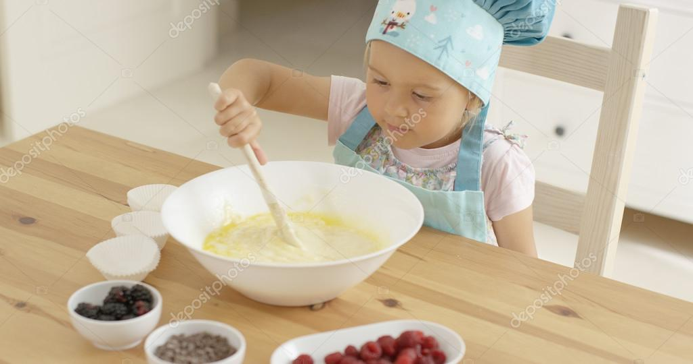
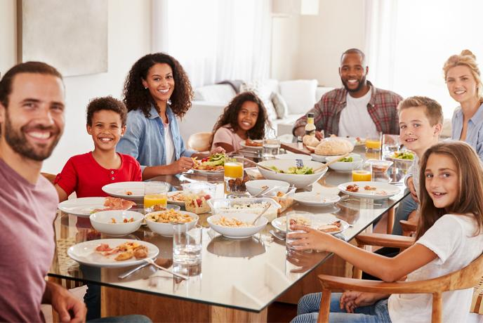
Everyone is trying something new or trying to get better at something. This cooking challenge will allow you all to practise your skills whether you are newbies or experienced cooks! I challenge you to try something new, create a dish or an entire meal for your family!

Slide 3
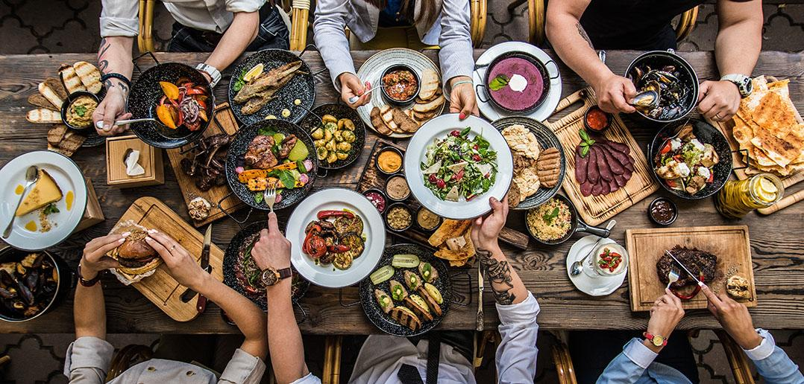
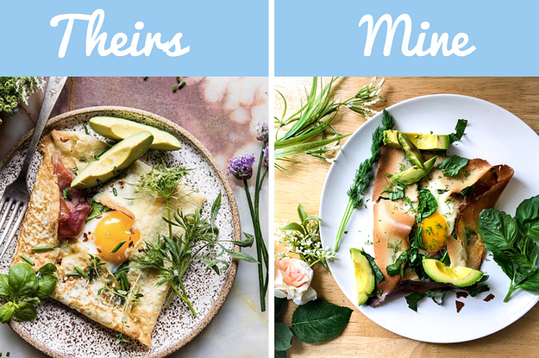
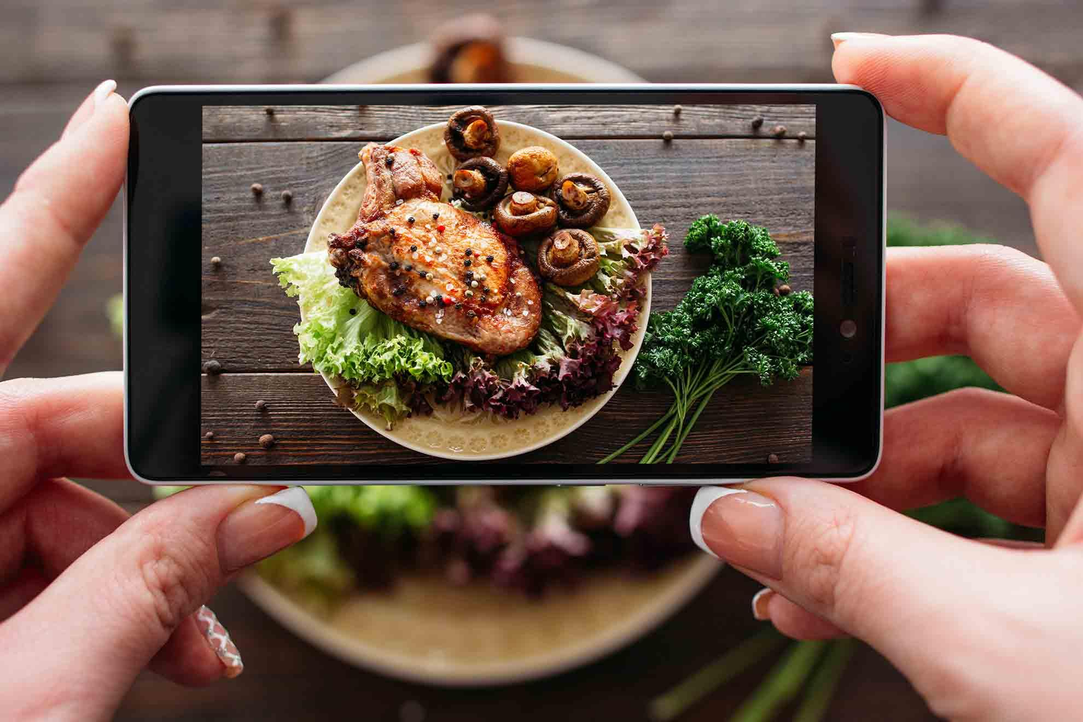
Whatever you choose to make, please send us pictures of your results! We’re all excited to see how you get on and try these recipes ourselves! Get a little competitive, submit your pictures and recipes, there may even be prizes! let’s see who will make the best dish and take the best insta-worthy photo!

Slide 4
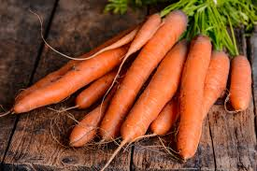
Why not try using carrots!?
I challenge you to create a dish, sweet or savoury that includes carrot as an ingredient. There are many health benefits to eating carrots, they are in season and will keep the Easter Bunny happy a little while longer!

Slide 5
Inspiration
Whether you fancy a snack, something sweet or savoury, there are many recipes from all over the world for you to try! I have included a recipe for a cake on the next few slides, but in case you fancy trying something different:
Carrot and cumin hummus:
https://www.bbcgoodfood.com/recipes/carrot-cumin-humous-swirled-harissa
Spiced carrot and lentil soup:https://www.bbcgoodfood.com/recipes/spiced-carrot-lentil-soup
Carrot, mushroom and hazelnut tart:
https://www.bbcgoodfood.com/recipes/golden-glazed-carrot-mushroom-hazelnut-tart
Skinny carrot fries:https://www.bbcgoodfood.com/recipes/skinny-carrot-fries
Gajar Halwa: https://food.ndtv.com/recipe-gajar-ka-halwa-218426

Slide 6
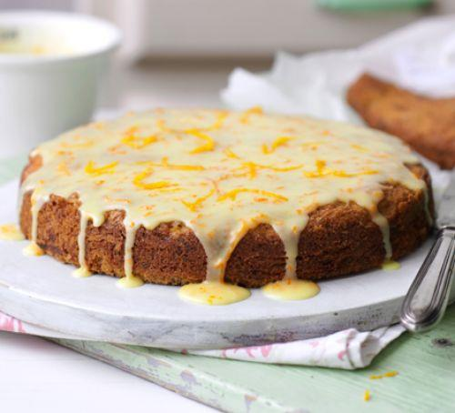
Carrot, Orange and Courgette Cake

Slide 7
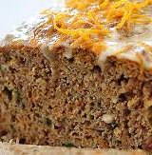
This is a great recipe, moist, delicious and actually pretty healthy for a cake! The method is also really easy, so it’s a great recipe for the less than confident bakers and really good to make with others.
Carrots are full of beta-carotene (where the orange colour comes from), which the body converts into vitamin A which is great for your eye and skin health.
Oranges are packed full of vitamin C, which supports your immune system.
Courgettes are also a great source of vitamin C as well as potassium, which supports muscle function and folic acid which supports the growth of new cells, particularly red blood cells.

Slide 8
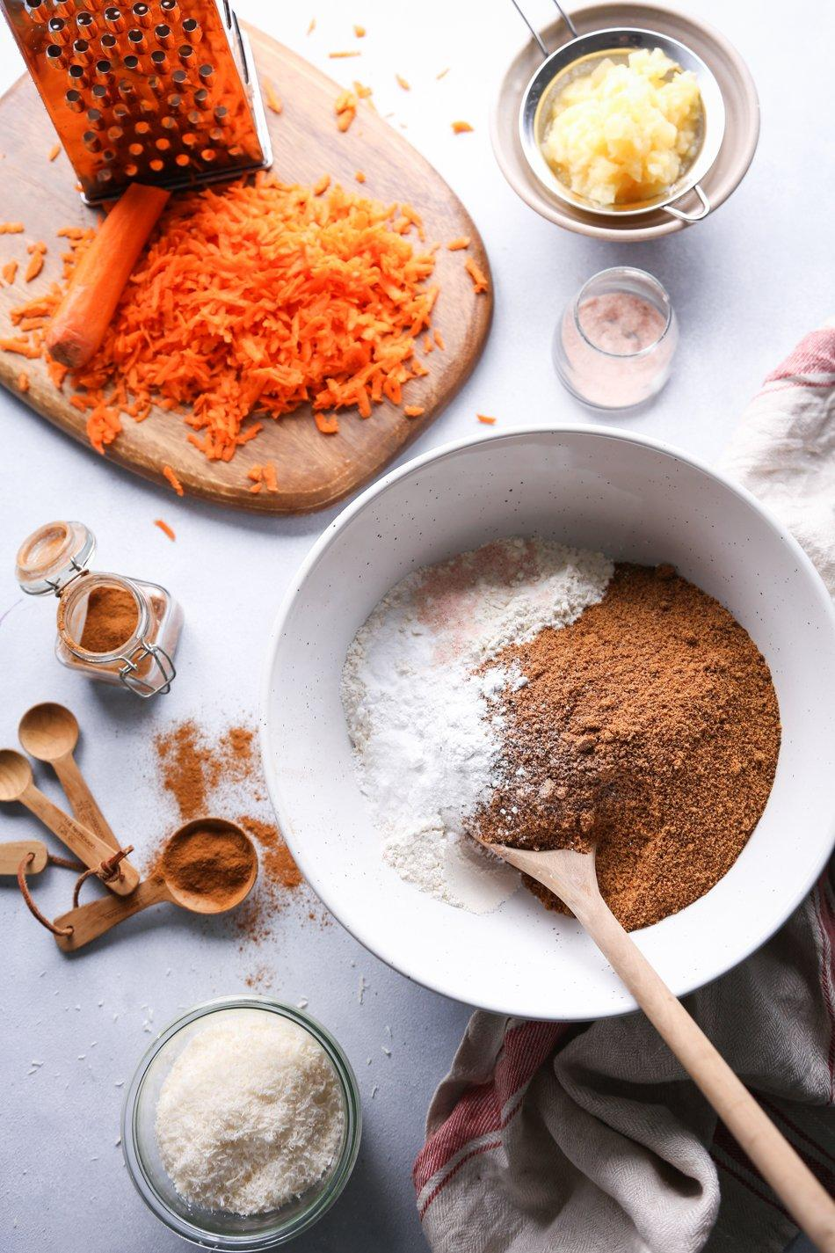
Ingredients
The sponge:
250g unsalted butter
200g caster sugar
3 large eggs
250g self raising flour
1 tsp bicarbonate soda
The zest of 2 oranges
1tsp of mixed spice (or cinnamon if you prefer)
100g carrots (grated)
100g courgette (grated)
The icing:
1 orange zested and 2-3 tbsp of juice
14og icing sugar (or caster if you don’t have any)

Slide 9
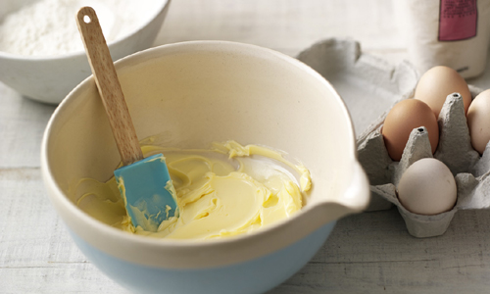
Method
This is a really easy all in one method, which means putting everything in the bowl together and mixing together. I’m a bit of a traditionalist, so I creamed my butter and sugar together first until pale and fluffy before adding the rest of the ingredients but this is entirely optional.
Preheat your oven to 180c/160c (fan) or gas mark 4.
Line and grease 2 x 20 cm cake tins or 2 loaf tins.
Weigh out your ingredients, and then put everything except for the grated veg into the bowl and mix thoroughly. Then fold in the grated veg.
Evenly distribute the mixture between the 2 tins and put them in the centre of the oven.
They should take about 25 mins to bake, keep an eye on them, they will be done when you can insert a skewer or knife and it comes out clean with no residual mixture on it.
Whilst the cake is in the oven, make the icing.
Mix together the icing sugar and the orange juice to make a smooth, runny delicious topping.
When the cake is done, either treat the cake as a drizzle cake, and give the cake a good stab all over and drizzle the icing over whilst the cake is still warm in the tin, or alternatively, once the cake is fully cool, remove from the tin and drizzle the icing over. The final step is to decorate with the final orange zest – enjoy!

Slide 10
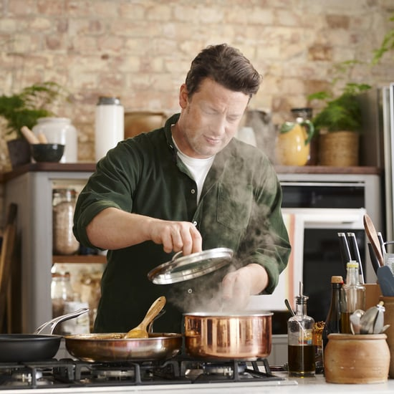
Jamie Oliver to the rescue!
Jamie Oliver has brought out a series that is really great in the current circumstances. He is cooking from home, with his family as his crew and managing with limited ingredients. All of his recipes come with ‘swap out’ suggestions, great if the cupboards are looking a little bare!
https://www.channel4.com/programmes/jamie-keep-cooking-and-carry-on

Slide 11
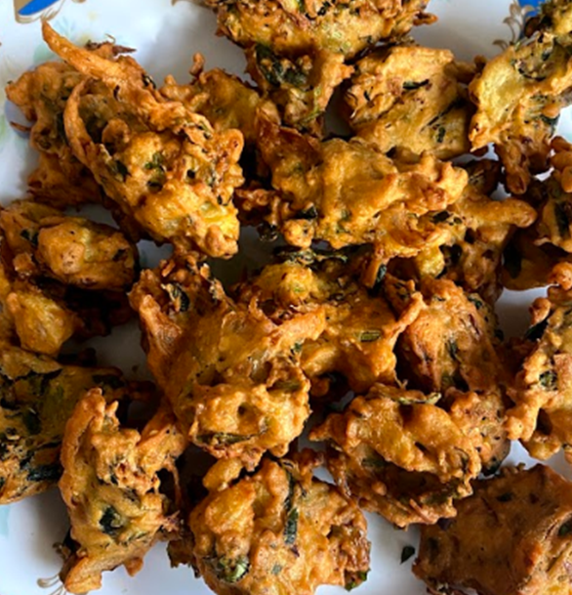
Easy Pakora Recipe
Serves 7-9

Slide 12
Ingredients
•300g of Gram flour
•One tablespoon of Chilli Flakes
•One heaped tablespoon of Coriander powder
•Fresh Coriander
•Two small Onions
•Two Medium Potatoes
•One heaped tablespoon of natural yogurt
•Fresh Spinach
•One teaspoon of salt
•Water
•Mixing bowl
•Vegetable Oil in frying pan- enough oil to deep fry pakoras

Slide 13
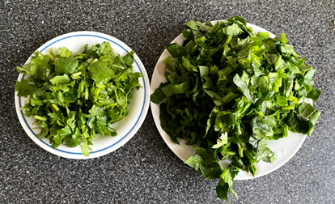
Instructions
1.Chop your potatoes into small cubes and your onions into long slices (could chop onions into small cubes also- whichever you prefer).
2. Chop your fresh coriander and spinach.

Slide 14
3. Add all your ingredients into a mixing bowl apart from the water.
4. Using water to add some liquid to the mixture, mix the mixture. For best results, use your hands. Only add enough water to form a mixture (gram flour should look like a paste).
5. Heat the oil.
6. Use a tablespoon to scoop even mixtures of the pakora mix into the oil.
7. Deep fry until the pakoras turn a golden brown colour.
8. Serve with delicious raita or chutney.

Slide 15
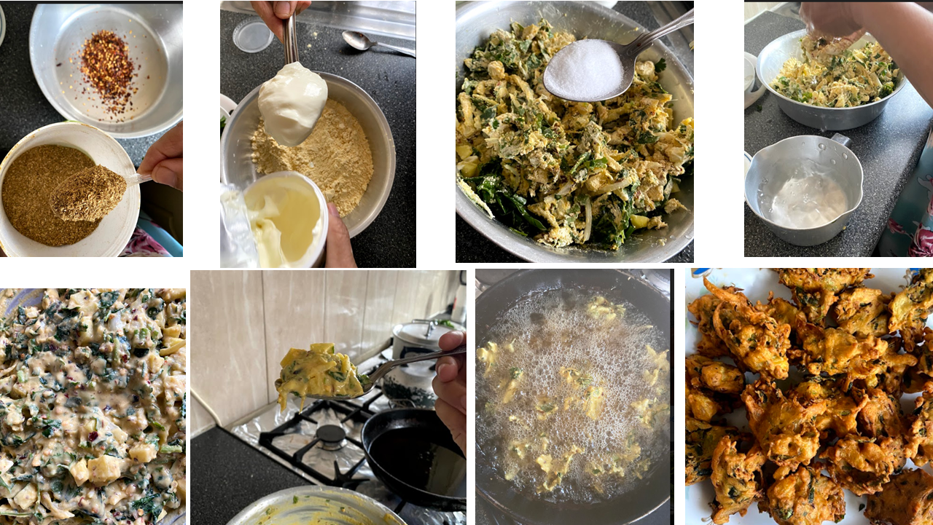

Slide 16
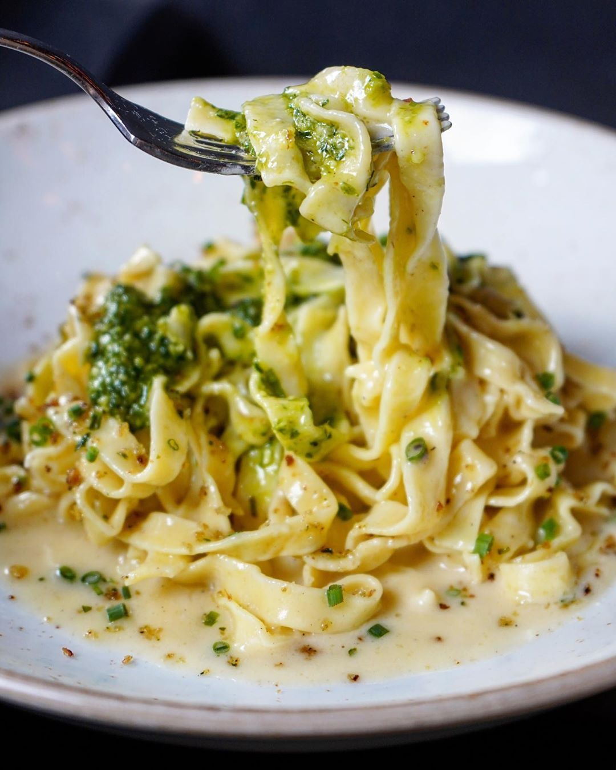
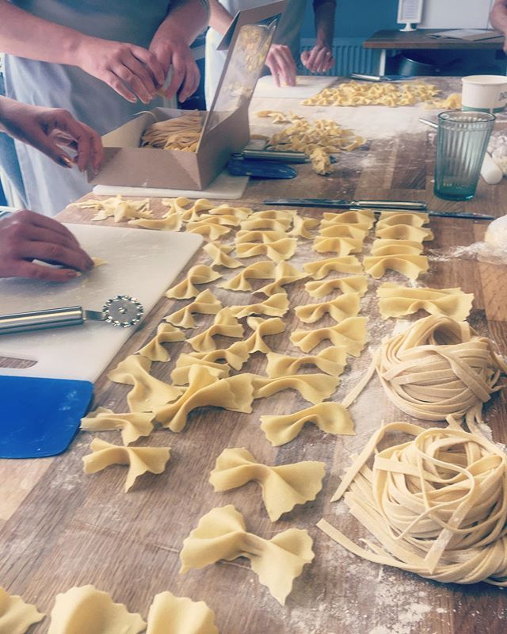
Easy fresh pasta
Why not try making pasta from scratch? Particularly as pasta isn’t easy to find in the shops due to the current circumstances. It can also be dried and stored to use another day!
If you have any leftover veggies, then you could be sitting down to ravioli or tagliatelle in under 2 hours! Lots of recipes call for ‘00’ flour, this is just extra fine flour, plain flour will work perfectly fine.
Here’s Jamie’s ‘Keep Cooking and Carry on’ version that doesn’t require eggs:
https://www.jamieoliver.com/recipes/pasta-recipes/super-quick-fresh-pasta/
Here are some more traditional versions that require eggs, but may give you the result you’re used to, including that yellow colour: https://www.bbcgoodfood.com/recipes/fresh-pasta
https://www.biggerbolderbaking.com/homemade-pasta-2-ingredient/

Slide 17
Remember!Whatever you choose to make, please send us pictures of your results! We’re all excited to see how you get on and try these recipes ourselves! Get a little competitive, submit your pictures and recipes, there may even be prizes! let’s see who will make the best dish and take the best insta-worthy photo!

