Slide 1
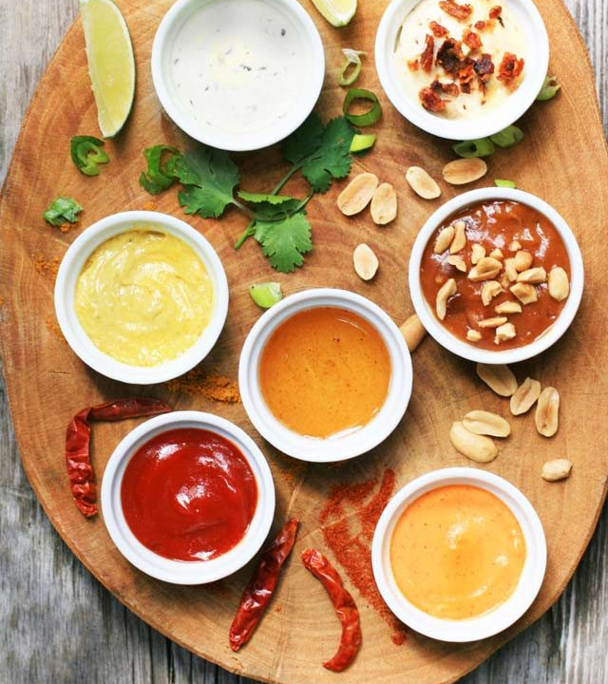
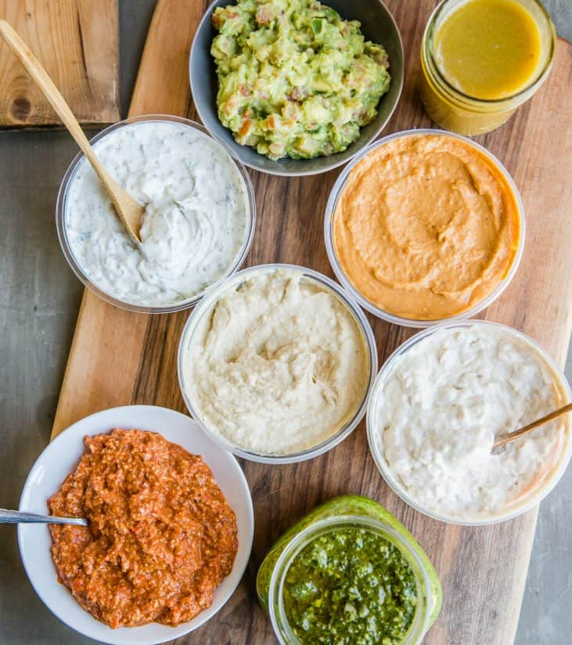
Cooking Challenge
Sides and accompaniments

Slide 2
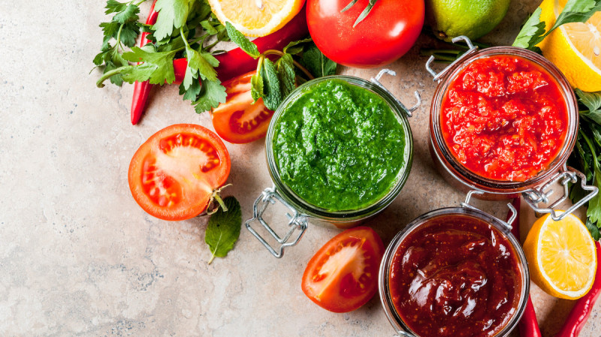
Chutney
Chutney originated in India, and it traditionally a combination of cooked fruit/veg and spices. We brought the idea home during the colonial era and translated it to include our own local produce.
It’s loved in my house, and a good dollop accompanies everything from curries to sandwiches and cold meat/cheese boards.
Raquia and I make our own, and we’ll teach you how!

Slide 3
Raquia’s Chilli Chutney

Slide 4
Charlie’s Caramelised Onion Chutney
This one is very popular in our family, and I make a massive batch every year for Christmas to give to my loved ones.
If you’re ready to give it a try, then you’ll need time and a whole lot of onions!

Slide 5
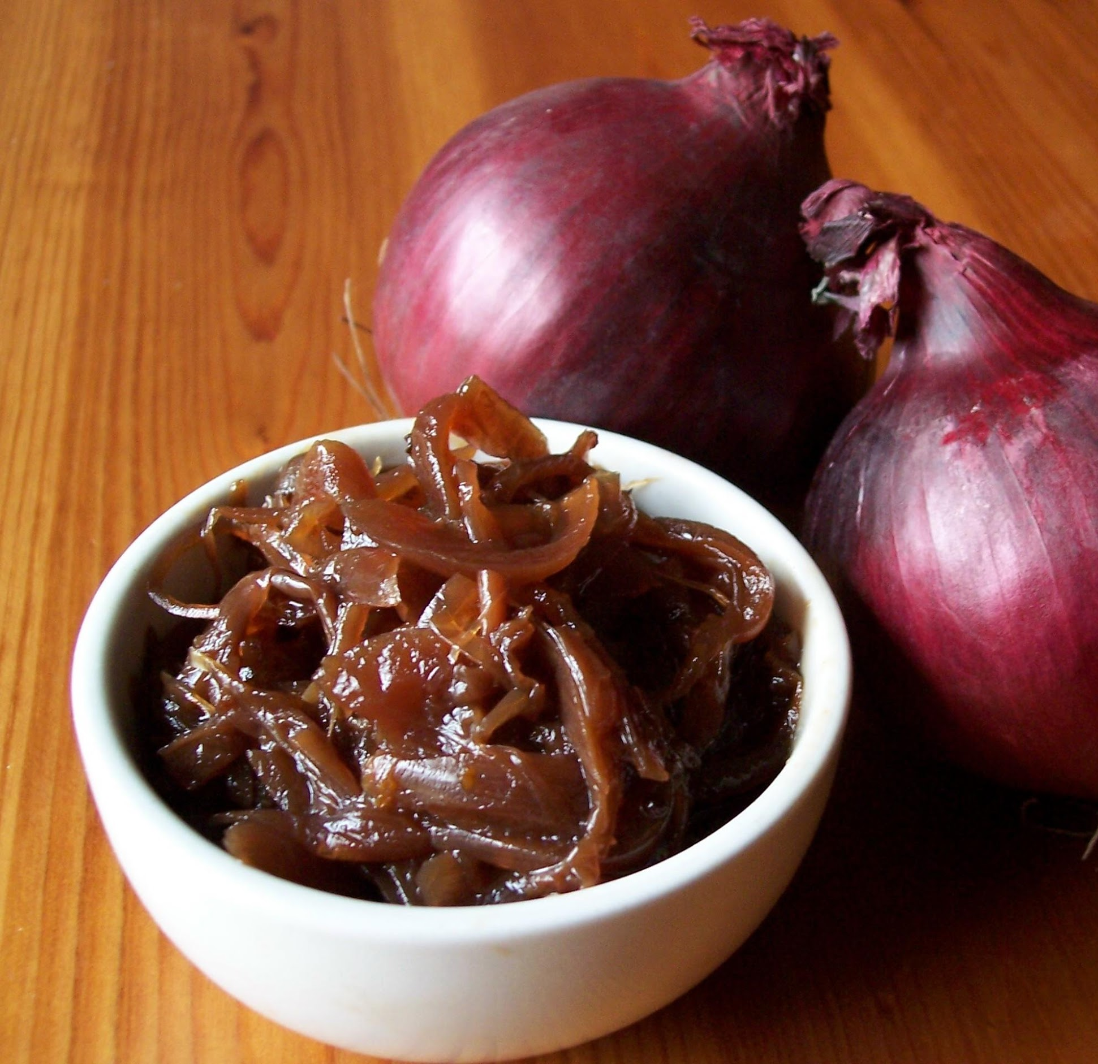
Ingredients
Sterilised jars and a funnel/jug.
1kg of onions (red is best)
Garlic 4 cloves – whole bulb depending on preference.
150 ml Balsamic Vinegar
150 ml White vinegar
200-250g Brown Sugar
100-150g Raisins/sultanas – pre soaked for a few hours to help them to cook down.
All spice/ cinnamon – 1-2tsp depending on preference.
2 bay leaves
Salt and pepper

Slide 6
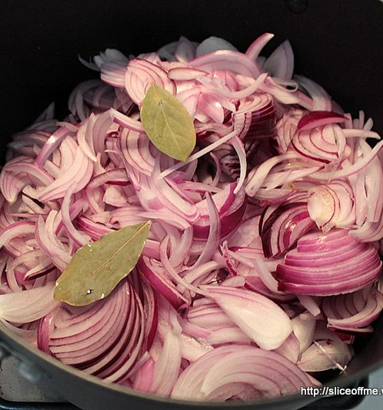
Method
Start by chopping your onions into fine slices/small cubes. You could use prechopped and frozen onions to save time but the taste isn’t the same.
Heat some oil at the bottom of a large pan and start to fry your onions at a low-medium heat to sweat down. Adding some salt at this point helps with this. You want to spend some time doing this, as this is where the caramelisation starts, so keep going until the onions start to turn brown.
Chop and add your garlic at this point, stirring continually.
Now add your raisins/sultanas. These contain natural pectin, the setting agent in fruit that helps to make jam sticky.
Add the rest of the salt and the pepper and keep stirring.
Now add your spices and bay leaves, stirring continuously.
Now add your vinegar and cook off the strong vinegar smell before adding the sugar.
Now increase the heat a little and keep stirring, you want the mixture to almost boil, be careful as it will spit! Keep stirring and cooking until the mixture turns that gorgeous, dark brown colour that you usually see with onion chutney. Keep tasting to ensure that it is seasoned to your liking, you can always adjust the vinegar/sugar to suit your preferences too.
Once the chutney is ready, whilst it is still very hot, start to fill your jars. I have a jam funnel, but labelling the mixture into a jug with a pouring spout will work too.
Once all the jars are full, put the lids on and leave to cool. The heat will help to seal the jar by activating the air seal mechanism in the lid. Voila! Chutney! This is ready to eat, but best left to continue to marinade. I usually make my Christmas batch weeks in advance, sometimes even months. The ingredients are naturally preserved in the vinegar and sugar so will keep as long as the jar is air tight.

Slide 7
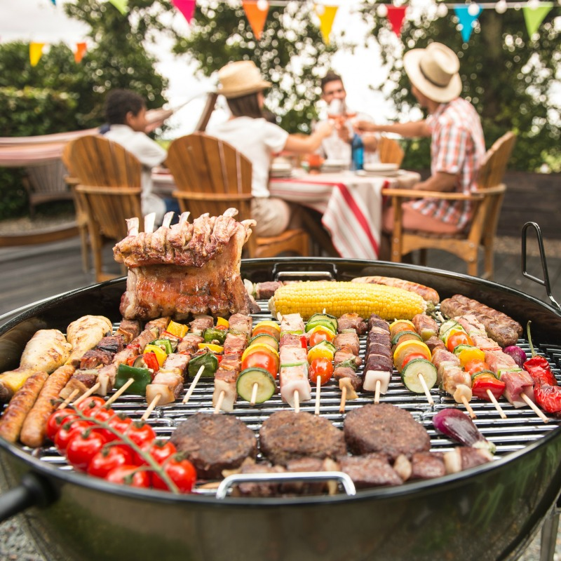
Summer essentials
The weather is improving and I’m looking forward to BBQ season – garden style.
It’s useful to have some culinary tricks up your sleeve to make the season easier and cheaper!
Potato Salad: https://www.bbcgoodfood.com/recipes/classic-potato-salad
Homemade salad dressing, much cheaper and healthier than shop bought: https://cookieandkate.com/how-to-make-vinaigrette-plus-variations/
Homemade BBQ sauce, there are loads of variations dependent on the region of origin but this is nice and simple, I use balsamic vinegar if I haven’t got apple cider in: https://www.kitchentreaty.com/our-very-favorite-homemade-barbecue-sauce/

Slide 8
More side ideas to try!
Authentic Homemade Hummus:https://www.themediterraneandish.com/how-to-make-hummus/
Proper Tzatziki (perfect to accompany your Spanakopita or Pitta from the previous challenges!): https://www.olivetomato.com/tzatziki-the-original-recipe-and-how-to-make-it-lighter/
Baba Ganoush (smokey aubergine and tahini dip, a bit like hummus) https://www.themediterraneandish.com/baba-ganoush-recipe/
Beetroot, mint and yoghurt dip :https://www.eatwell.co.nz/recipe/12206/Beetroot-mint-and-yoghurt-dip/
Red pepper, feta and Greek yoghurt :https://www.olivetomato.com/red-pepper-dip-with-feta-cheese-and-greek-yogurt/
‘Green’ Chutney (chilli, mint and coriander) :https://www.bbcgoodfood.com/recipes/green-chutney
Tomato chutney:https://www.bbcgoodfood.com/recipes/homemade-tomato-chutney
Mango Salsa – my absolute favourite to serve with spicy barbequed chicken: https://thehappyfoodie.co.uk/recipes/mad-mango-salsa

