Slide 1
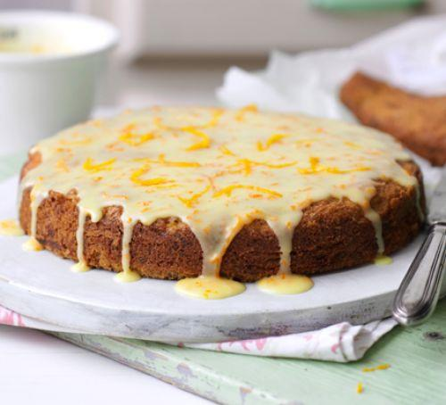
Carrot, Orange and Courgette Cake

Slide 2
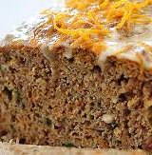
This is a great recipe, moist, delicious and actually pretty healthy for a cake! The method is also really easy, so it’s a great recipe for the less than confident bakers and really good to make with others.
Carrots are full of beta-carotene (where the orange colour comes from), which the body converts into vitamin A which is great for your eye and skin health.
Oranges are packed full of vitamin C, which supports your immune system.
Courgettes are also a great source of vitamin C as well as potassium, which supports muscle function and folic acid which supports the growth of new cells, particularly red blood cells.

Slide 3
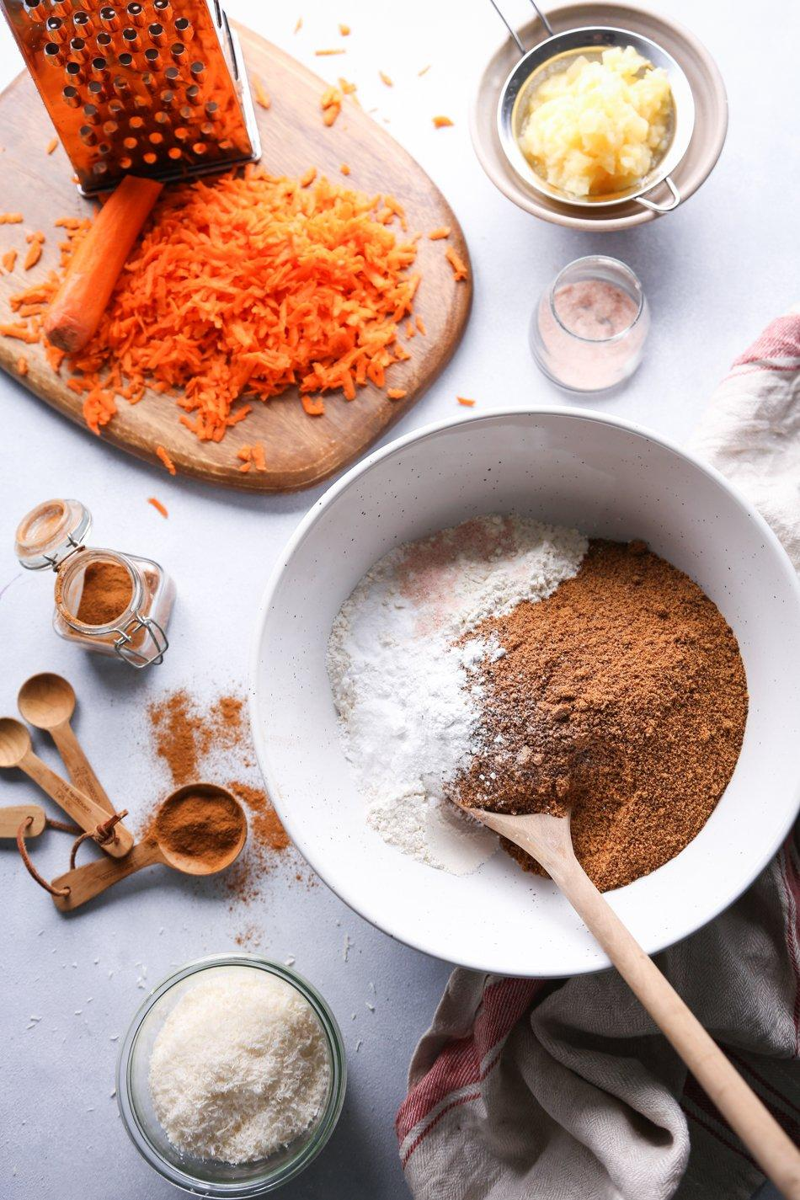
Ingredients
The sponge:
250g unsalted butter
200g caster sugar
3 large eggs
250g self raising flour
1 tsp bicarbonate soda
The zest of 2 oranges
1tsp of mixed spice (or cinnamon if you prefer)
100g carrots (grated)
100g courgette (grated)
The icing:
1 orange zested and 2-3 tbsp of juice
14og icing sugar (or caster if you don’t have any)

Slide 4
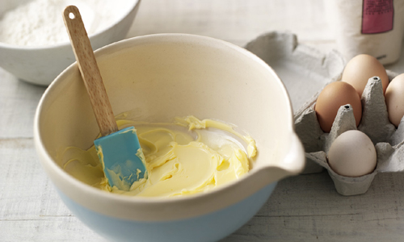
Method
This is a really easy all in one method, which means putting everything in the bowl together and mixing together. I’m a bit of a traditionalist, so I creamed my butter and sugar together first until pale and fluffy before adding the rest of the ingredients but this is entirely optional.
Preheat your oven to 180c/160c (fan) or gas mark 4.
Line and grease 2 20 cm cake tins or 2 loaf tins.
Weigh out your ingredients, and then put everything except for the grated veg into the bowl and mix thoroughly. Then fold in the grated veg.
Evenly distribute the mixture between the 2 tins and put them in the centre of the oven.
They should take about 25 mins to bake, keep an eye on them, they will be done when you can insert a skewer or knife and it comes out clean with no residual mixture on it.
Whilst the cake is in the oven, make the icing.
Mix together the icing sugar and the orange juice to make a smooth, runny delicious topping.
When the cake is done, either treat the cake as a drizzle cake, and give the cake a good stab all over and drizzle the icing over whilst the cake is still warm in the tin, or alternatively, once the cake is fully cool, remove from the tin and drizzle the icing over. The final step is to decorate with the final orange zest – enjoy!

